Slide 1
Stroke Prediction
Using machine learning

Slide 2
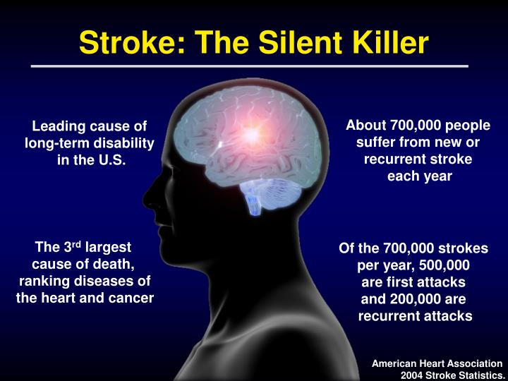
Stroke
A stroke is a medical condition in which poor blood flow to the brain causes cell death.
A stroke happens when there is a loss of blood flow to part of the brain. Your brain cells cannot get the oxygen and nutrients they need from blood, and they start to die within a few minutes. This can cause lasting brain damage, long-term disability, or even death.
According to the World Health Organization more than 10 million die due to stroke every single year around the world.

Slide 3
Risk Factors
High blood pressure :This is the primary risk factor for a stroke.
Diabetes.
Heart diseases, Atrial fibrillation and other heart diseases can cause blood clots that lead to stroke.
Smoking : When you smoke, you damage your blood vessels and raise your blood pressure.
A personal or family history of stroke or TIA.
Age : Your risk of stroke increases as you get older.

Slide 4
Prevention using Machine Learning
Given the disease burden of strokes, prevention is an important public health concern
The main challenge in today's healthcare is provision of best quality services and effective accurate diagnosis .
The proposed work makes an attempt to detect these stroke at early stage to avoid disastrous consequences.
Prevention of stroke - More than 70% of strokes are first events, thus making primary stroke prevention a particularly important aspect.
Interventions should be targeted at behavior modification, which however requires information about the baseline perceptions, knowledge and prevalence of risk factors in defined populations.
Data mining techniques are the means of extracting valuable and hidden information from the large amount of data available.
Machine Learning (ML) which is subfield of data mining handles large scale well-formatted dataset efficiently.
In the medical field, machine learning can be used for diagnosis, detection and prediction of various diseases.

Slide 5
ML plays a very important role to detect the hidden discrete patterns and thereby analyze the given data.
After analysis of data ML techniques help in stroke prediction and early diagnosis.

Slide 6
Objectives
The goal of the project is to apply different machine learning
The goal of the project:
The objective of this study is the early detection of stroke.
To apply different machine learning techniques over the large existing dataset, which is based on the risk factors.
To develop the a website
To provide a personalized warning based on stroke risk
To provide lifestyle correction message about the stroke risk factors.

Slide 7
Existing System
The
Strokes are usually diagnosed by doing physical tests and studying images of the brain produced during a scan. When you first arrive at hospital with a suspected stroke, the doctor will want to find out as much as they can about your symptoms.
A number of tests can be done to confirm the diagnosis and determine the cause of the stroke.
This may include:
A blood test to find out your cholesterol and blood sugar level, checking your pulse for an irregular heartbeat taking a blood pressure measurement.
Disadvantages:
The process is costly and time consuming.

Slide 8
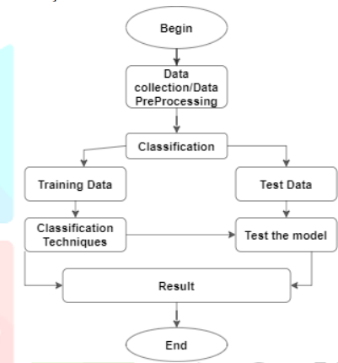
Proposed System
The proposed work predicts stroke by exploring classification algorithms and does performance analysis.
The health professional enters the input values from the patient's health report.
The data is fed into model which predicts the probability of having stroke.
Voting summarizes the methodology we will use to compare various training models.

Slide 9
Input/Output and Modules
Inputs
Outputs
A Questionnaire is provided in the website which need to be filled in by the user.
It consists of 10 questions whose answers goes in as inputs like age, gender, ever married, hypertension, work type, residence type, heart disease, avg glucose level, smoking status and BMI.
The output is whether the person is having stroke or not.
The outcome of the most accurate learning algorithm is shown as output.
The value of the output is either 1 or 0.
The number 0 indicates that no stroke risk was identified, while the value 1 indicates that a stroke risk was detected.
Healthy Lifestyle messages are provided.

Slide 10
Modules
User Module:
Users enter the information regarding age, gender, hypertension, heart disease, BMI, Smoking status, Glucose level etc.. into the system.
2. Data Preparation Module:
Missing data analysis, Handling Imbalanced data through SMOT technique, Label Encoding
3. Model Creation Module:
Model is trained using a variety of classification methods such as K-Nearest Neighbor, Random Forest, XGBoost algorithms.
4. Evaluation Module:
Analysis of performance of classifiers based on machine learning techniques by voting classifier.

Slide 11
Architecture
ANALYSIS
Prediction of stroke.
System architecture is the conceptual model that defines the structure, behavior, and more views of a system.
An architecture description is a formal description and representation of a system, organized in a way that supports reasoning about the structures and behaviors of the system.
MACHINE LEARNING
ALGORITHMS
KNN RandomForest XGB
Data Preprocessing
Label encoding dataset splitting Missing values
INPUT DATA
Risk factors like Gender, Age , Hypertension, Marriage status, smoking status, glucose level, bmi etc..

Slide 12
System Specification
SOFTWARE SPECIFICATION
Operating system: Windows 11
Front end : HTML, CSS, JavaScript.
Back end : Python.
IDE : Google Collaboratory.
Web browser : Google Chrome.
HARDWARE SPECIFICATION
Processor : 11th Gen Intel(R) Core(TM) i3-1115G4 @ 3.00GHz 3.00 GHz
Hard disk : 1 TB
RAM : 8.00 GB
Monitor :15.6” W LED DISPLAY

Slide 13
Algorithms used in prediction
Three algorithm is used to predict stroke, where all of them uses different classification techniques.
Accuracy of each of the algorithm is drawn out using confusion matrix and corresponding classification report is also generated.
A voting classifier is used to find the output from the model that has greatest chance of being selected as output.

Slide 14
Random Forest
Random Forest algorithms are used for classification as well as regression.
It creates a tree for the data and makes prediction based on that.
Random Forest algorithm can be used on large datasets and can produce the same result even when large sets record values are missing.
In random forest there are two stages, firstly create a random forest then make a prediction using a random forest classifier created in the first stage.

Slide 15
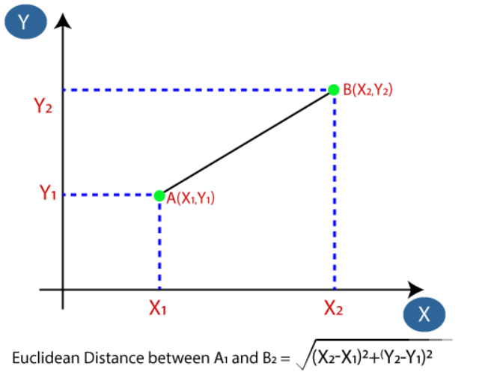
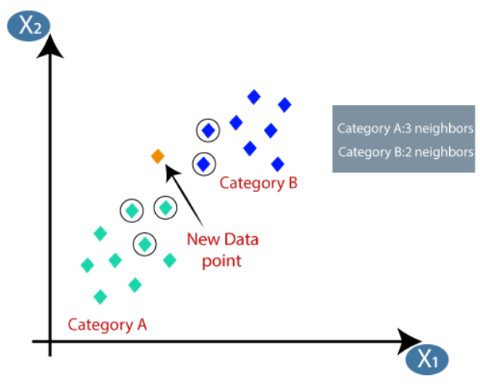
K-nearest neighbor classifier
k-nearest neighbors (KNN) algorithm is a type of supervised ML algorithm which can be used for both classification as well as regression predictive problems
The following two properties would define KNN well −
Lazy learning algorithm − KNN is a lazy learning algorithm because it does not have a specialized training phase and uses all the data for training while classification.
Non-parametric learning algorithm − KNN is also a non-parametric learning algorithm because it doesn’t assume anything about the underlying data.

Slide 16
XGBoost classifer
XGBoost is an ensemble learning algorithm meaning that it combines the results of many models, called base learners to make a prediction.
XGBoost is an optimized distributed gradient boosting library designed to be highly efficient, flexible and portable.
It implements machine learning algorithms under the Gradient Boosting framework.
XGBoost provides a parallel tree boosting (also known as GBDT, GBM) that solve many data science problems in a fast and accurate way.

Slide 17
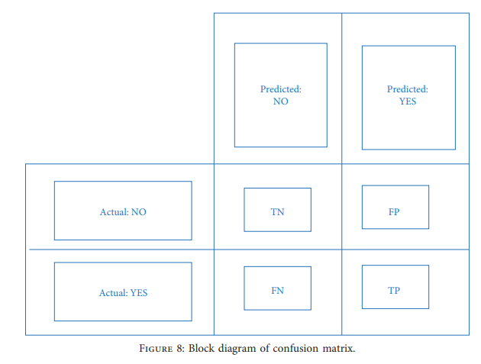
Confusion matrix
A confusion matrix is a table that is often used to describe the performance of a classification model (or "classifier") on a set of test data for which the true values are known.

Slide 18
Voting Classifier
A Voting Classifier is a machine learning model that trains on an ensemble of numerous models and predicts an output (class) based on their highest probability of chosen class as the output.
It simply aggregates the findings of each classifier passed into Voting Classifier and predicts the output class based on the highest majority of voting. The idea is instead of creating separate dedicated models and finding the accuracy for each them, we create a single model which trains by these models and predicts output based on their combined majority of voting for each output class.
Soft voting: In this phase, the predicted probability gradients for each model are added and averaged. -e category with the highest value is deemed the winner, and its contents are the output.
Hard voting: -is phase combines the categorization outputs of all the various models and specifies the final output value as the mode value of the resultant output.

Slide 19
Datasets
Here we used the heart stroke dataset that is available in the kaggle website for our analysis. This dataset consists of total 12 attributes. The complete description of the attributes used in the proposed work is given below:
id : This attribute means person’s id. It’s numerical data.
Age : This attribute means a person’s age. It’s numerical data.
Gender : This attribute means a person’s gender. It’s categorical data.
Hypertension : This attribute means that this person is hypertensive or not. It’s numerical data.
work type : This attribute represents the person work scenario. It’s categorical data
residence type : This attribute represents the person living scenario. It’s categorical data.

Slide 20
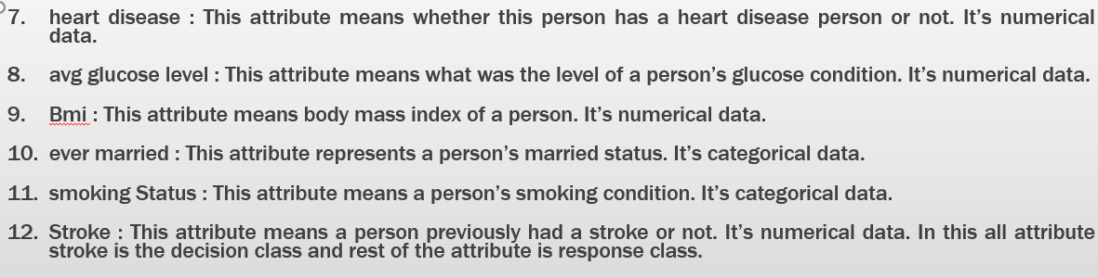

Slide 21
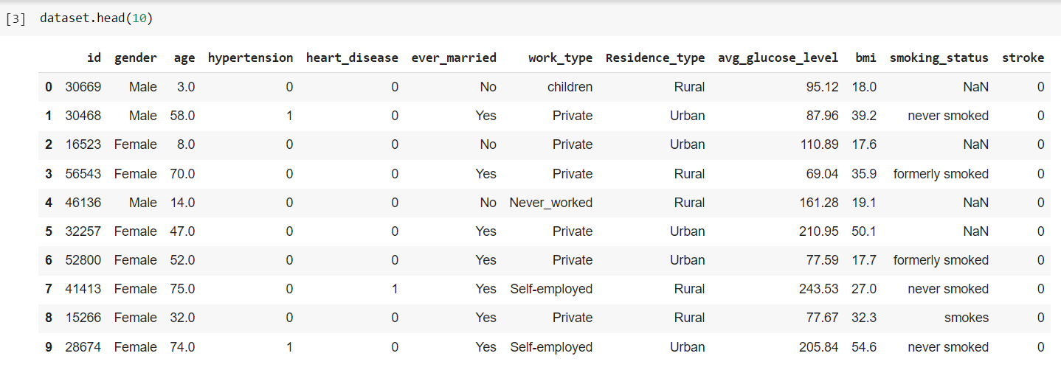

Slide 22
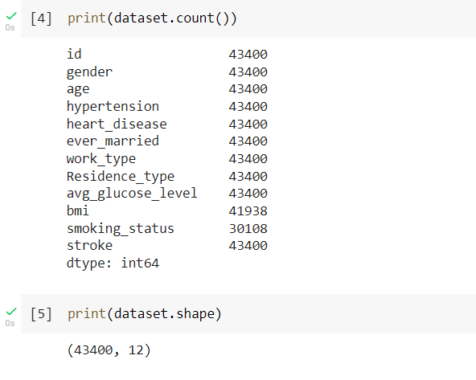

Slide 23
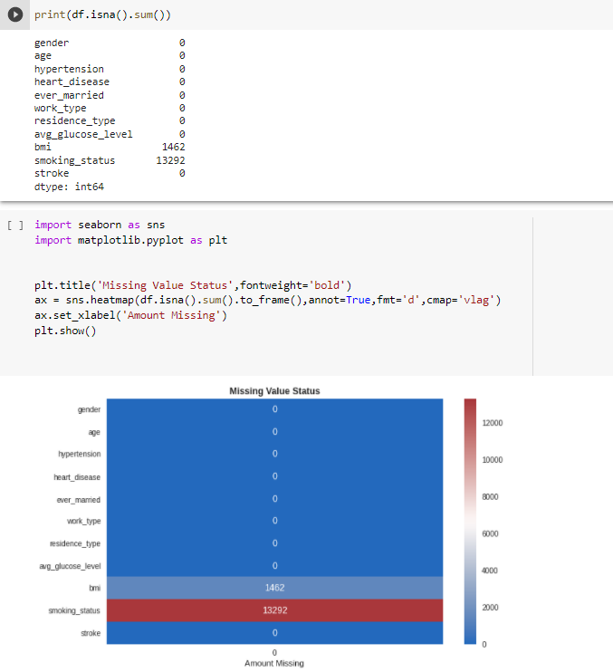
Progress of the project
Data Preparation tasks done

Slide 24
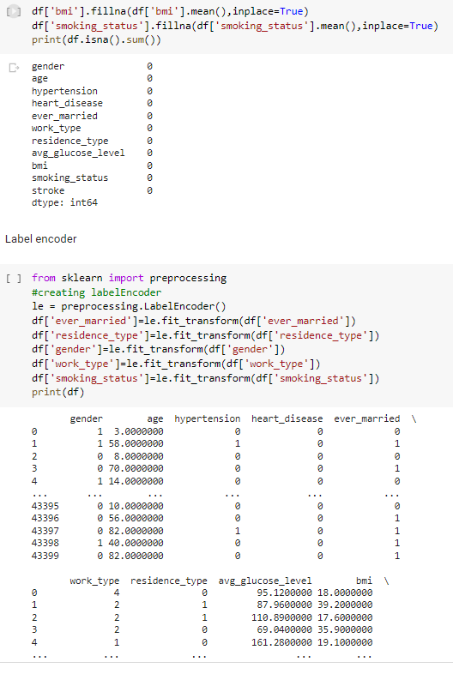

Slide 25
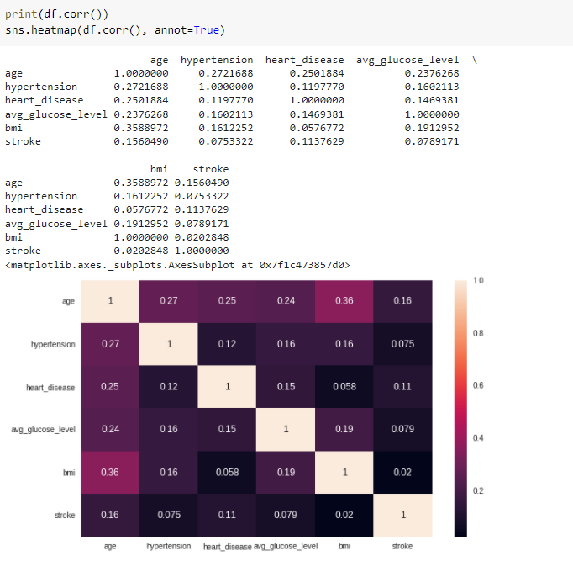

Slide 26
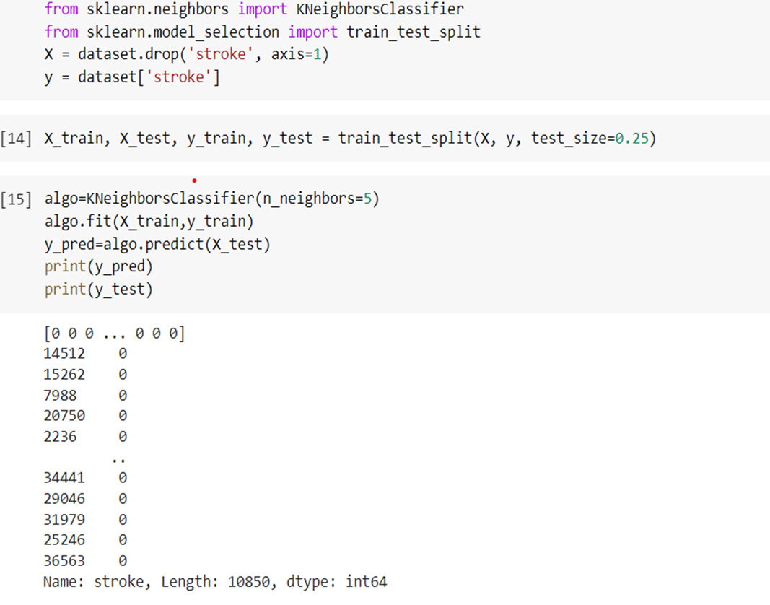
KNN classifier applied over the dataset

Slide 27
THANK YOU

